Slide 1
MDT – Malt deployment toolkit
Phil Schwan
Solution Architect
Netrix LLC
Fred Bainbridge
Systems Consultant
NowMicro

Slide 2
Phil Schwan
Fred Bainbridge
@philschwan
@FredBainbridge
MCSE: Enterprise Devices & Apps, Mobility
Fantasy Baseball Champion
Almost 20 years desktop engineering
1 Year of Brewing
Running and Brewing FTW
Beer. (Not too cool for an IPA)

Slide 3
agenda
LET’S MAKE SOME BEER!

Slide 4
agenda
Why do we brew?
How does one brew?
What do you need?

Slide 5
“This is actually good”
-People who drink your homebrew

Slide 6
Getting started - Expectations
You can make good beer. It is easy. Great beer? Not so easy.
You are unlikely to save money, at least at first.
Lager vs. Ale
You will be brewing an Ale when you first start.
Notes:
With great beer there is a lot of hardwork and precision that goes into great beers.

Slide 7
Getting started - WHY
Who makes a good brewer?
Likes good beer
Likes a good detailed process
Likes analytics
Has patience
Being a clean freak helps.
Notes:
This slide sucks

Slide 8
Brewing Basics
How does this all work?

Slide 9
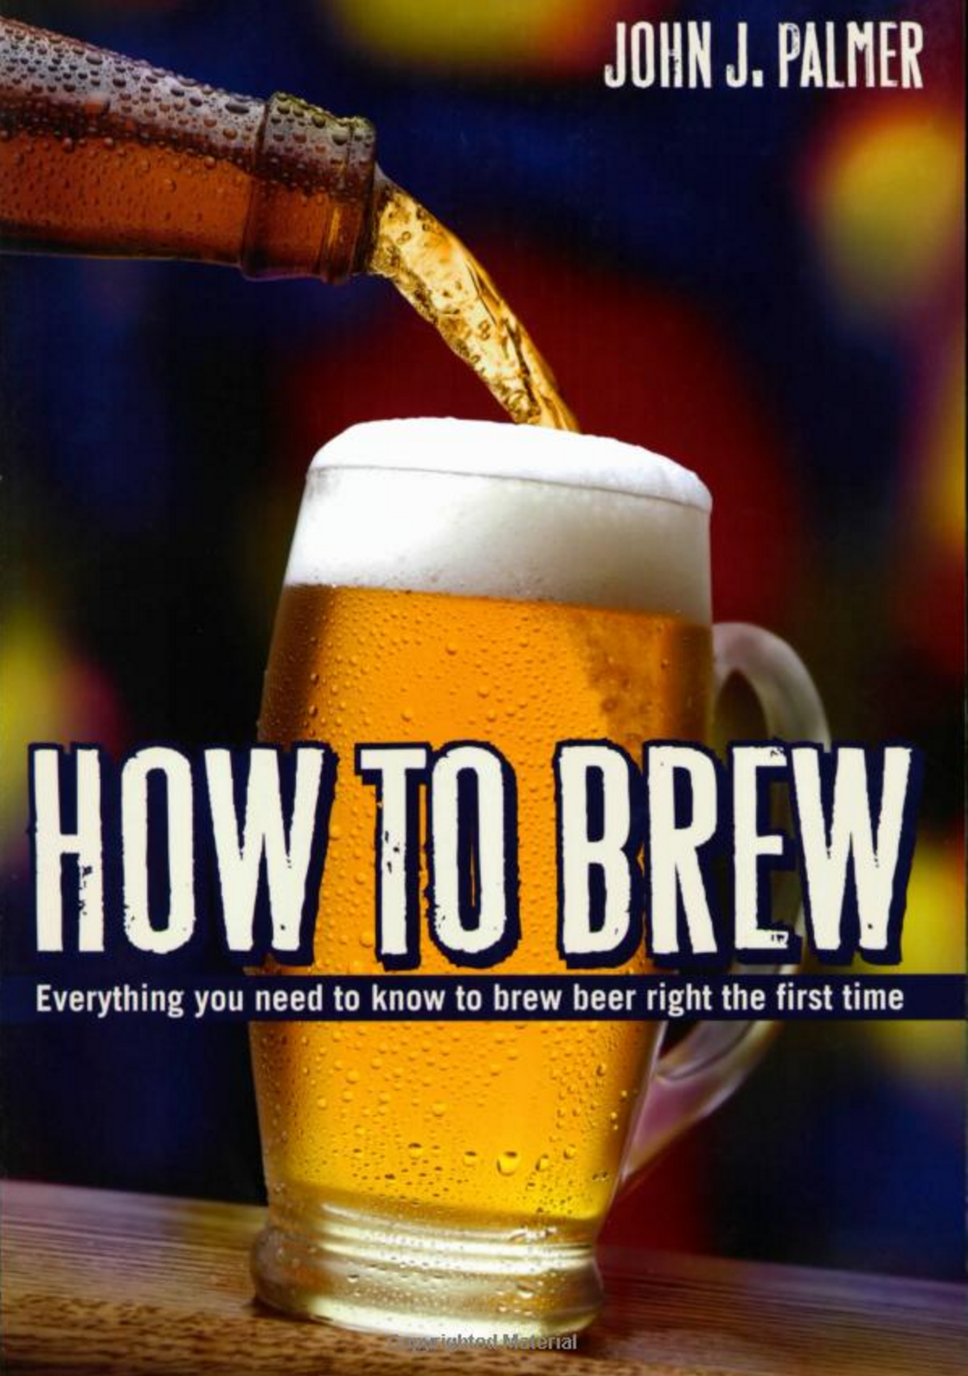
Getting started - TIPS
Read this book.
Online for free
http://howtobrew.com/
Notes:
This book is the equivalent of learn powershell in a month of lunches.

Slide 10
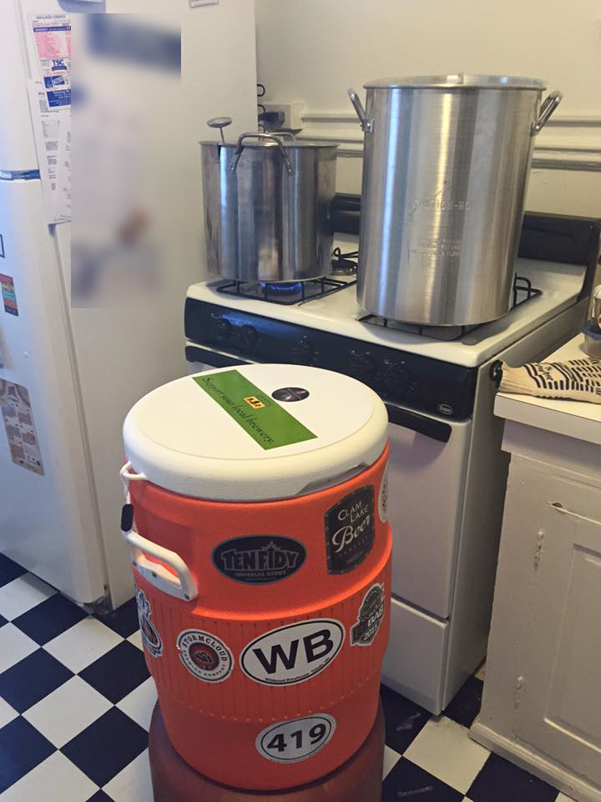
Getting started - TIPS
Don’t over do it on the equipment
Look on Craigslist for equipment!
Build your own stuff.
Keep it simple! S.M.A.S.H.
Single Malt and Single Hops
(You won’t take this advice, its ok)
Notes:
Start with simple equipment because if you don’t like brewing you haven’t lost much. Better equipment doesn’t make better beer. Good brew process makes for a better beer, good equipment makes for a comfortable / scalable brew. Easy cleanup, etc.
When building your equipment be prepared too go to your local hardware store 8-10 times. It is fun to ask for help, the staff generally get excited when they know they are helping someone brew beer.
Starting simple has a few benefits. It takes some time to get your process down as far as equipment and workspace go. Your first brews you going to be highly sensitive to your environment and process, no need to add the overhead of a complex beer recipe. Save the complexity for when you are comfortable with your workspace and equipment and you don’t have to constantly be thinking about it. That’s the time you want to start looking at making a complex beer.

Slide 11
Brewing Basics
Brewing Methods
All Grain vs Extract
How to Brew
1. Extract Sugar From Grain using hot water to make wort. (Mash)
2. Boil the wort for an hour. Add hops occasionally.
3. Cool the boiled wort.
4. Add yeast and store for 3+ weeks.
5. Bottle if needed.
Notes:
We are going to be talking about all grain brewing. It is way more fun. Extract brewing is great, you can make good beer with extract brewing. But, again, grain brewing is more fun.
Here is how you

Slide 12
BREW DAY!!
It’s a great day.
Notes:
We are going to walk through a bew day in great detail here. Stopping to talking in detail about the process and equipment.

Slide 13
Brew Day Tips
Give yourself enough time.
Have patience.
Have a clean workspace.
Be Prepared
Notes:
We are going to be talking about all grain brewing. It is way more fun. Extract brewing is great, you can make good beer with extract brewing. But, again, grain brewing is more fun.
Here is how you

Slide 14

The night before (WATER PREP)
Water. Your first opportunity to geek out.
Get a water report, you have to call for this
Water profile can dictate what beers you can make well.
BOOK: Water: A Comprehensive Guide for Brewers
Pour the water the night before
Bypass your water softener! (unless you want a salty beer)
Chlorine tastes bad. Leave water out over night to dissapate.
Did you forget? Camdem Tablets (potassium metabisulfite)
Notes:
Some water can’t make some beers. This is a hard truth you may have to deal with.

Slide 15
The Mash (Extracting Sugar FROM GRAINS)
“Mashing is the brewer's term for the hot water steeping process which hydrates the barley, activates the malt enzymes, and converts the grain starches into fermentable sugars.”
"- John Palmer
The Equipment (Mash Tun)
[PICTURE]
How to build
Notes:
You can buy a mash tun or you can build your own. Any standard 48 quart picnic cooler will work. What you

Slide 16
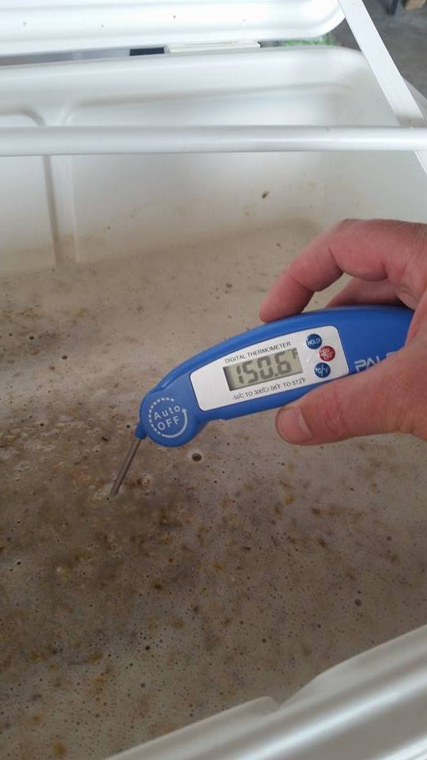
The Mash (Continued)
The goal is to get your grain soaking in water between 148-160 degrees for 60+ minutes.
Over 170 degrees will stop all enzyme reactions.
Under 140 degrees will not get the right enzymes extracted.
You don’t want the temp to drop more than 5 degrees during the mash.
A standard Coleman® cooler can do this without a problem.
Notes:
Some water can’t make some beers. This is a hard truth you may have to deal with.

Slide 17
starting The Mash - WATER
Heat the Mash Tun! (add hot water, close the lid, swish it around)
Amount of water to use (Ratio) - quarts of H20 / lbs of Grain
1.5 is fine.
Strike Temp
(.2 / RATIO) * (TargetTemp – InitialTemp) + TargetTemp
Or appx 12 degrees hotter than your desired mash temp.
To hot? Stir it up. Too Cold? Add hot water.
Notes:
Heat the mash tun so as not to loss heat when adding water. Have thermometer handy, a grill thermometer works great.

Slide 18
Adding grain to the Water
Add the grain to the water.
Check your temp and make sure you are at your desired temp.
Stir to cool, add water to heat it.
Stir up the grains gently, but thoroughly! You have to break up all the dough balls in order to get good extraction.
Have a big perforated paddle for this.
Close up the cooler and let the chemistry happen.
Notes:
If

Slide 19
Advanced Mash - PH
The desired PH level for your mash is between 5.0 and 5.6.
Depending on your water and grain this can be challenging to hit.
You can make good beer if your mash PH is off.
Every 10-15 minutes you can take a sample from the Mash tun and measure the PH and see how you are doing.
Manipulating the Mash
Grains -> Dark grains will lower your mash
Acid will lower you rmash PH
Sodium Bicarbanate will raise your mash PH.
Notes:
This is the fun stuff. If you are screwing around with this, either know your chemistry or use a tool to help you. You need an accurate water report and a decent PH tester if you want to get serious about controlling your PH.
You may be lucky and have good water and never have to worry about this. (i.e. Chicago)

Slide 20
The Lauter, VerlouFing and Sparging
This is getting the wort out of our mash tun and into the boil kettle.
Equipment – Boil Kettle
Probably the most expensive piece of equipment if you buy it.
You can fashion a keg into one. (requires a propane burner)
Nice to haves –
Attached Thermometer
Size, bigger is better.
Handles / Grips
Notes:
A big boil kettle is nice to prevent boil overs and to be able to account for boil off or adding of water.

Slide 21
Extraction Percentage
The amount of sugar you extract from the grain vs. the total amount of sugar available is extraction percentage.
The Sugar is what turns into alcohol.
More grain = more sugar = stronger beer
High efficiency is harder with higher gravity beers.
Notes:
A big boil kettle is nice to prevent boil overs and to be able to account for boil off or adding of water.

Slide 22
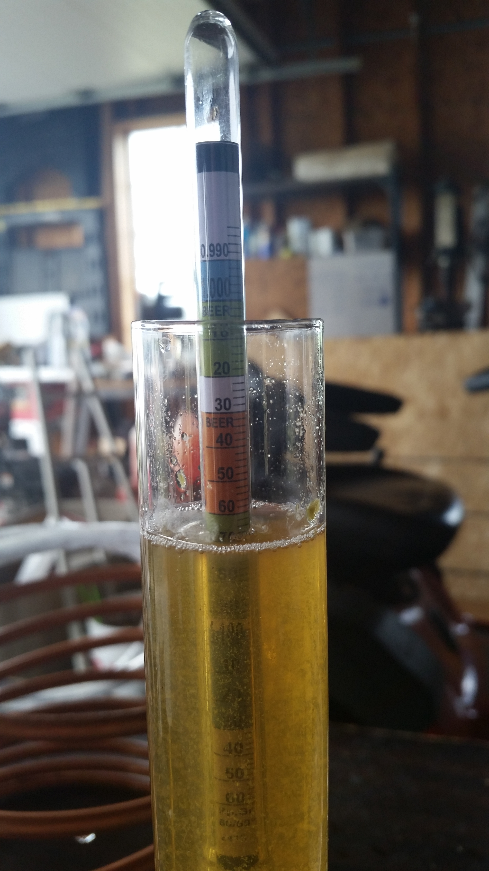
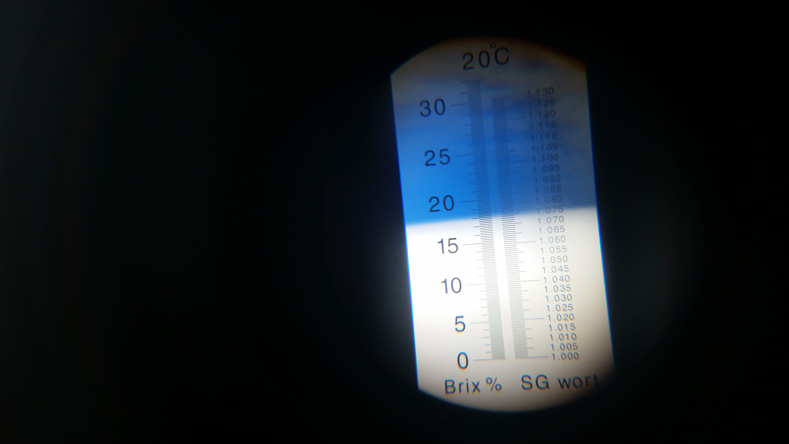
Gravity
The amount of sugar in your wort is measured based on a Gravity measurement.
You measure gravity using a hydrometer or refractometer!
ABV = (Starting Gravity – Final Gravity) * 131.25
Notes:
A big boil kettle is nice to prevent boil overs and to be able to account for boil off or adding of water.

Slide 23
VerlouF
DO THIS
Tjis
Notes:
A big boil kettle is nice to prevent boil overs and to be able to account for boil off or adding of water.

Slide 24
Basics
Water
Grain
Yeast
Fermentation

Slide 25
Prepare the water in advance.
Bypass your water softener.
Chlorine tastes bad. Leave it out over night to rid yourself of that trash.

Slide 26
Brewing Tips and Tricks
How does do I not screw this up?

Slide 27
Brewing Automation
IoT - Intoxication of Things?

Slide 29


Slide 30
agenda

Slide 31
Title
Line1
Bullet Level 1
Bullet Level 2
Bullet Level 3

Slide 32
Title
Code

Slide 33
Text Only with Border
Level 1
Level 2
Level 3

Slide 34
Text Only (Red)
Level 1
Level 2
Level 3

Slide 35
Title
Text 1
Level 1
Level 2
Level 3
Text 2
Level 1
Level 2
Level 3

Slide 36
Title
Section 1
Section 2
Text
Level 1
Level 2
Level 3
Text
Level 1
Level 2
Level 3

Slide 37
Demo Title

Slide 38





























Slide 39






























Slide 40




























Slide 41




























Slide 42




























Slide 43




























Slide 44




























Slide 45























Slide 46
















